Slide 1
A Comparative Study of Different Lock-free Linearizable Queues
Shagun : CS23MTECH14013
A Phani Sahasra : CS23MTECH14008
Aishwarya Dash : CS23MTECH14001
Course name: Parallel & Concurrent Programming 2023

Slide 2
OBJECTIVES
This project aims to implement and compare three lock-free queue in terms of performance efficiency and scalability.
Lock-free data structures aim to minimize contention and improve parallelism in multi-threaded applications without the need for traditional locking mechanisms like mutexes or semaphores.
We aim to implement the following algorithms :
1. Circular Queue (Ring Buffer)
2. Basket Queue
3. Wait-Free Queue using fast-path slow-path method
We build above three queues based on existing literature and ensure that the queues adhere to FIFO property and satisfies consistency.

Slide 3
Circular Queue (Ring Buffer)
Its a lock-free multiple-producer and multiple-consumer (MPMC) FIFO queue design which is also linearizable.
The approach involves building ring buffers using indirection and two additional separate queues.
Use of single-width CAS operations instead of double-width CAS, aids in enhancing portability across different CPU architectures like PowerPC, MIPS, SPARC and RISC-V. This algorithm can run virtually anywhere.

Slide 4
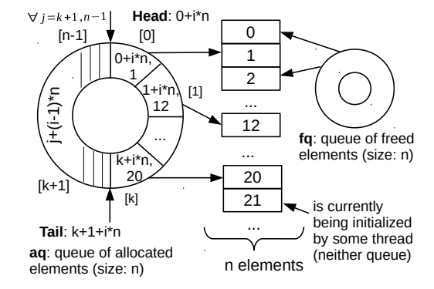
Data-structure Design
1. The design is based on two key ideas.
First, we use indirection, i.e., data entries are not stored in the queue itself. Instead, a queue entry simply records an index into the array of data.
Second, we maintain two queues:
‘fq’ -> which keeps indices to unallocated entries of the array,
‘aq’ -> which keeps allocated indices to be consumed.
2. Actual data entry values are stored in a separate array whose indexes that are available for enqueue/dequeue are stored in the circular queues ‘fq’ and ‘aq’.

Slide 5
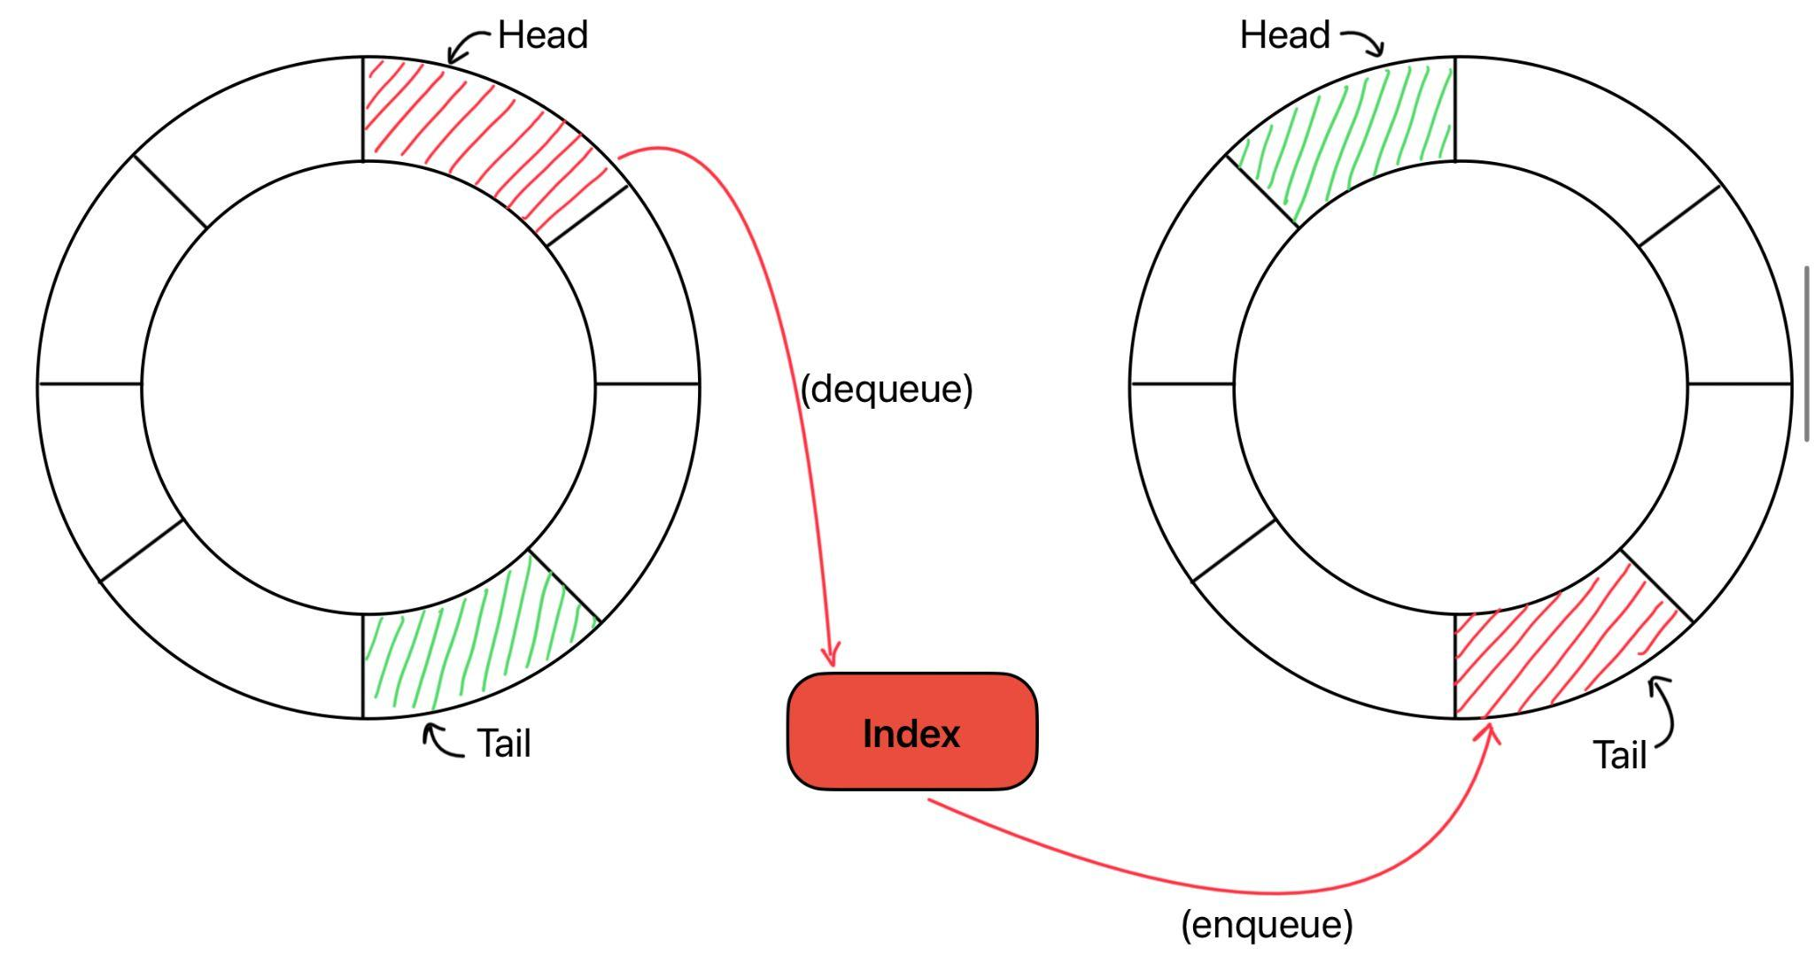
PRODUCER
‘fq’
‘aq’
A producer thread will dequeue an index from fq . If NULL / -1 is returned the queue is full, else, will return a valid index in which case we write data to corresponding index and insert the index into aq.

Slide 6
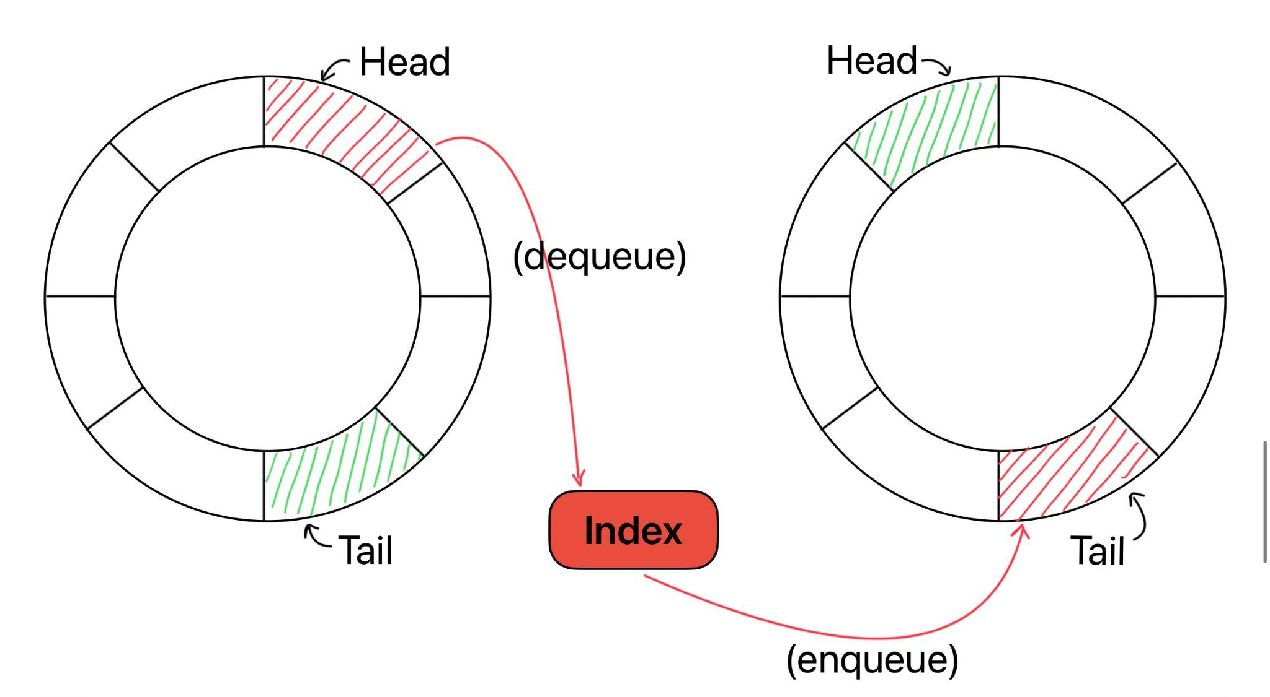
CONSUMER
‘aq’
‘fq’
A consumer thread will dequeue index from aq . If NULL/-1 is returned the queue is empty, else, we get a valid index in which case we read the data from data array and insert the entry back into fq.

Slide 7
Queue Class for ‘aq’ and ‘fq’
Each queue has an n sized array called entries which will store the cycle and index of the elements
in queue. It can be represented as follows :
Entries[] array -> Each entry contains <cycle, index>.
Each index can be represented as : i * n + j
Where, i = cycle number ;
n = queue capacity ;
j = index denotes position in circular array
• ‘aq’ is initialized to be an empty queue. All entries are initialized to cycle 0 and Head = n , Tail = n
• ‘fq’ is initialized to be a full queue. It will contains all the n entries. All entries are initialized to cycle 0 and Head = 0 , Tail = n

Slide 8
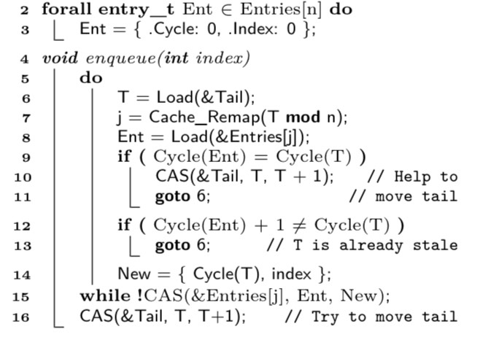
Enqueue Algorithm
• New entry (Tail / N , value) is enqueued at index = (tail % N)
• Tail must be one cycle in front of the current entry.
• If Tail’s cycle number is same as entry’s cycle number =) Some other thread has enqueued but has not advanced tail. So we increase tail for global progress.
• If both the conditions are satisfied we are reading an old value of tail ( n enqueues happened). So we again fetch the new value of tail.
• If the conditions are satisfied we do a Compare & Swap operation to update the entry at this index with new entry ( Cycle(Tail) , value)

Slide 9
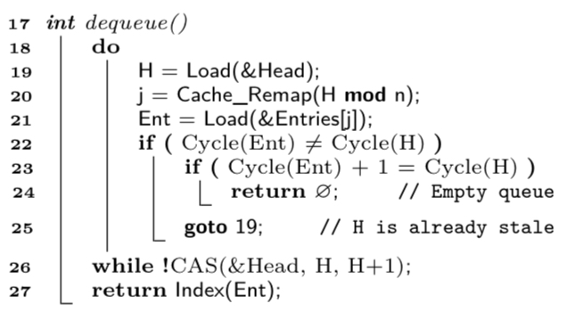
Dequeue Algorithm
• Cycle number of current entry and Head should match.
• If Head is one cycle ahead =) empty queue in this case we return NULL.
• In any other case we are reading an old value. So we again fetch the new value of Head

Slide 10
Circular Queue Algorithm
Initialization:
1. int* data;
2. Queue *aq, *fq;
3. int capacity;
4. Constructor:
CircularQueue(int capacity):
5. data = new int[capacity];
6. aq = new Queue(0, capacity);
7. fq = new Queue(1, capacity);
Enqueue Operation (enque_data method):
8. pair<int, timeval> enqueIndex = fq->dequeue()
9. data[enqueIndex] = val;
10. timeval enqueueTime = aq->enqueue(enqueIndex);
11. return {1, enqueueTime};
Dequeue Operation (dequeue_data method):
12. pair<int, timeval> dequeIndex = aq->dequeue();
13. int val = data[dequeIndex];
14. timeval enqueueTime = fq->enqueue(dequeIndex);
15. return {val, enqueueTime}

Slide 11
Linearization Points =>
For successful enqueue(), LP is line 10 of CQ AlgorithmFor successful enqueue, LP is Line 10 of CQ algorithm
For successful dequeue(), LP is line 14 of CQ AlgorithmFor successful dequeue, LP is Line 14 of CQ algorithm
The Algorithm is Lock-Free because :
CASE 1 :
• If CAS operation fails in the enqueue it again repeats the loops, =) the entry Entries[j] was
updated by another thread who called enqueue method ; dequeue method didn’t modify entries
Array.
=) That other thread was making progress and it succeded in its enqueue operation.
CASE 2 :
• If CAS operation fails in the dequeue it again repeats the loops, =) the Head pointer was updated
by another thread who called dequeue method ; enqueue method didn’t modify head pointer.
=) That other thread was making progress and it succeded in its dequeue operation.

Slide 12
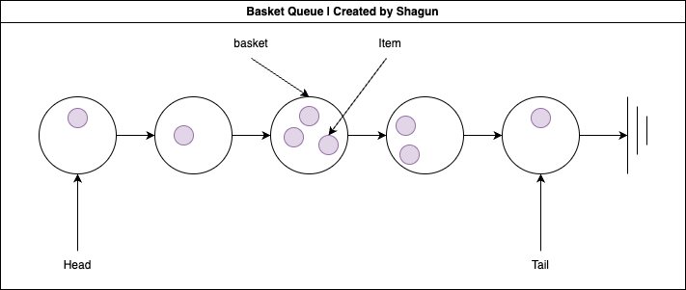
Basket Queue

Slide 13
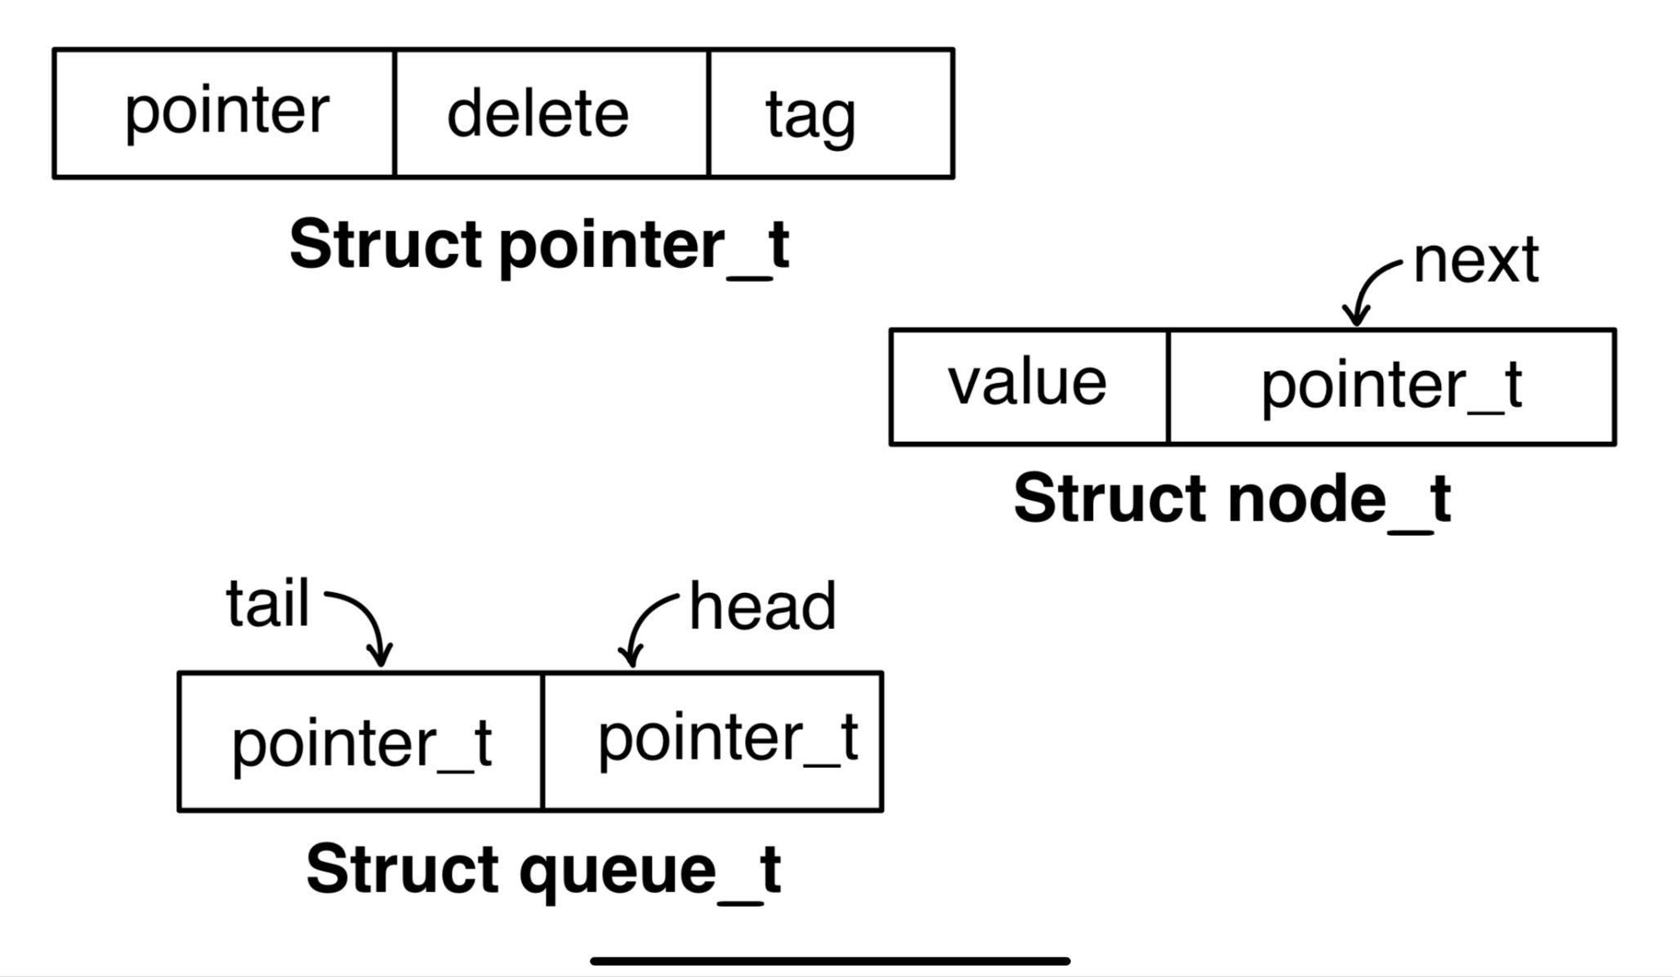
Types , Data Structures and Algorithms

Slide 14
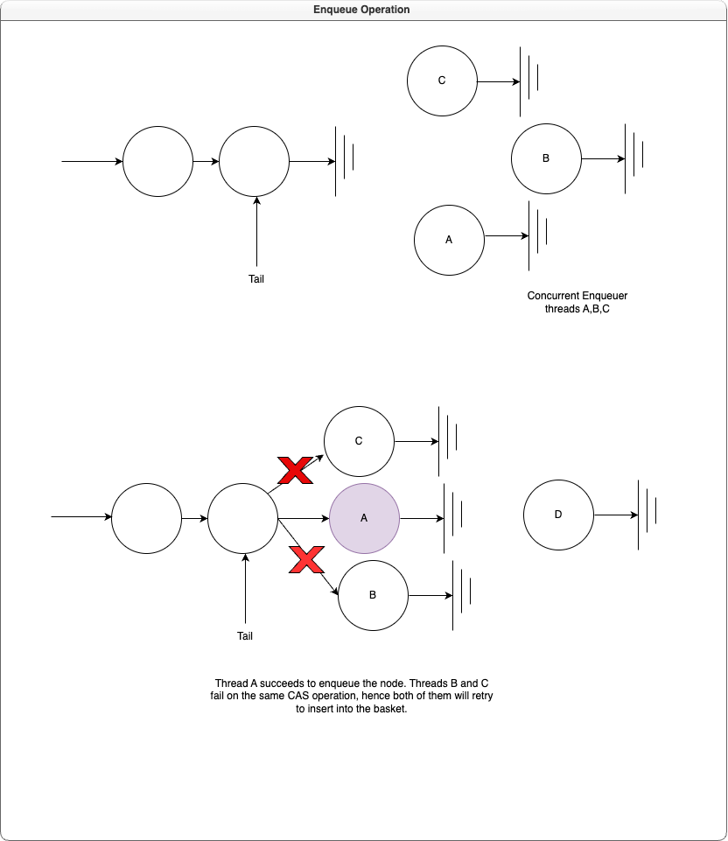
Enqueue

Slide 15
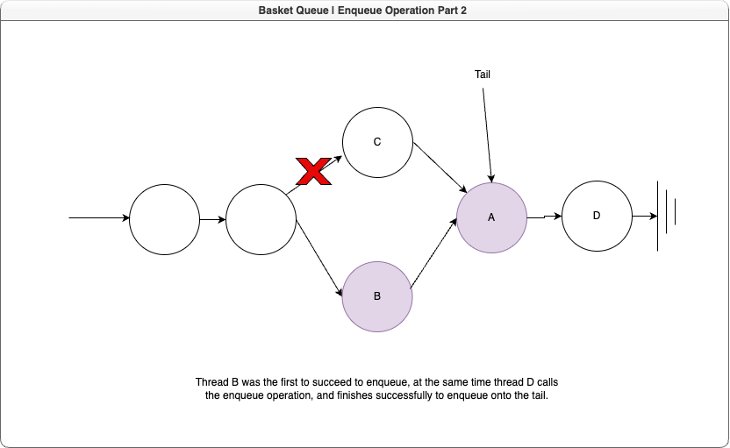
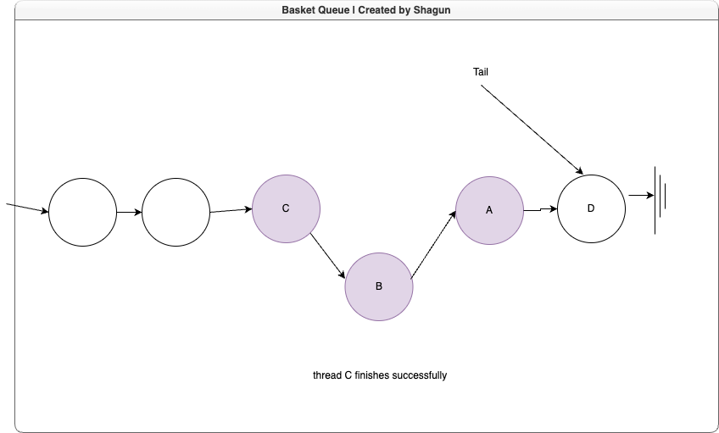
Enqueue

Slide 16
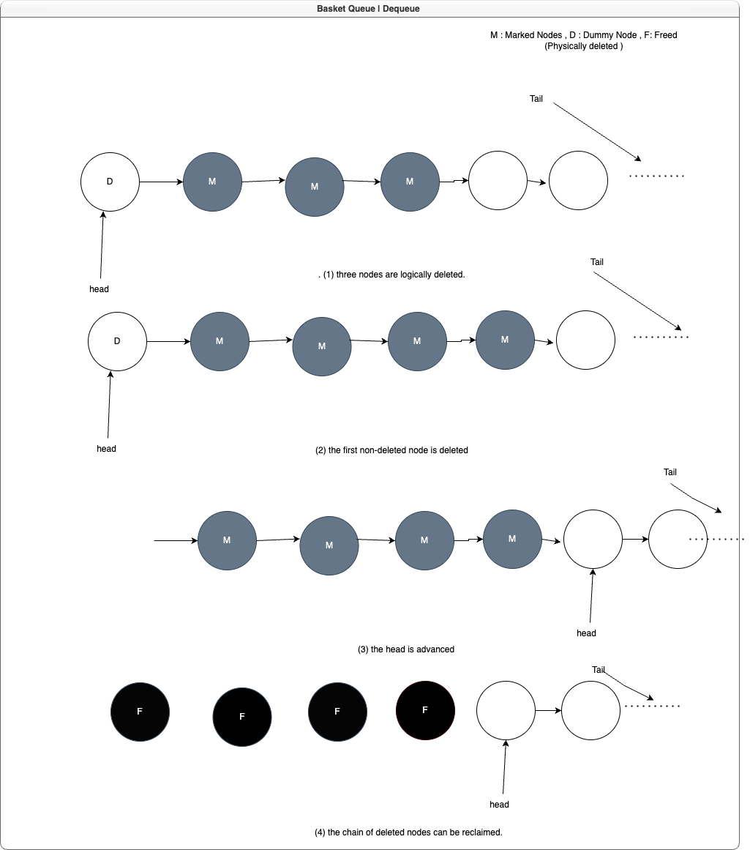
Dequeue

Slide 17
ABA Problem ??
ABA problem is dealt by BQ by use tags

Slide 18
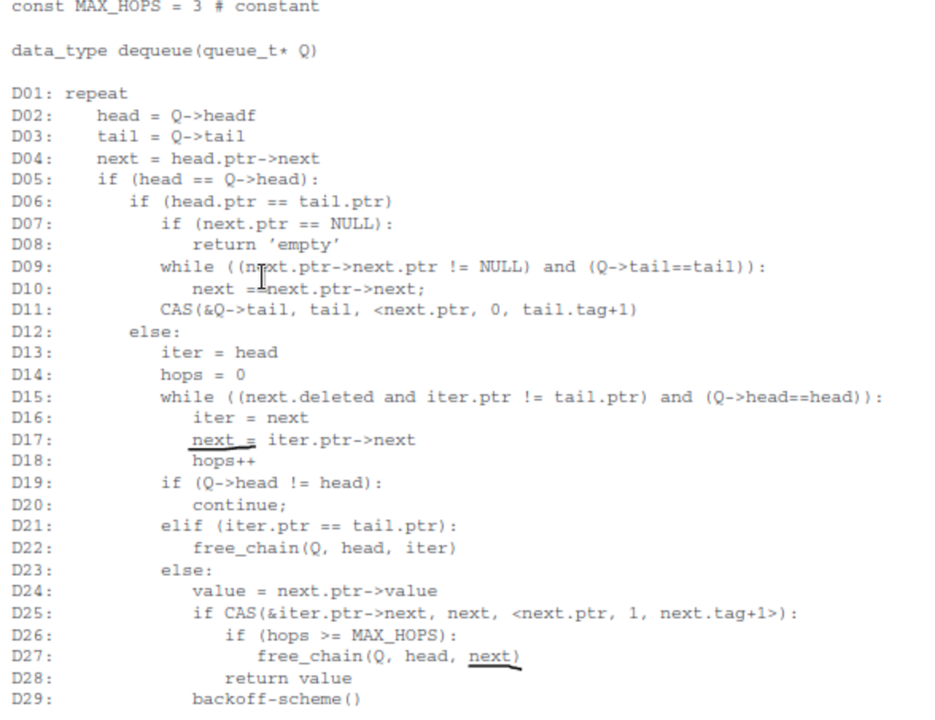
BQ
Dequeue Algorithm

Slide 19
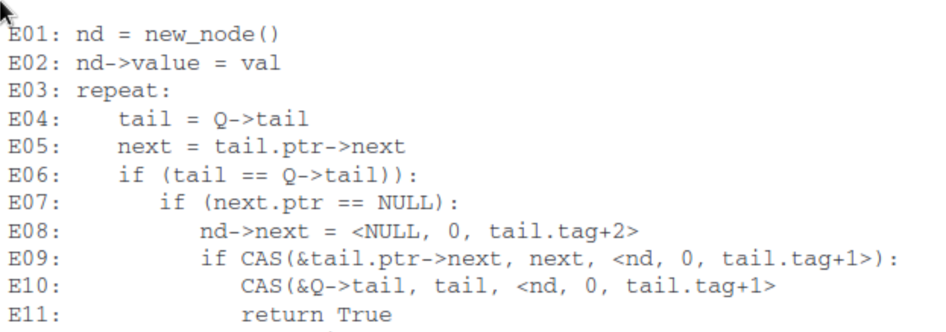
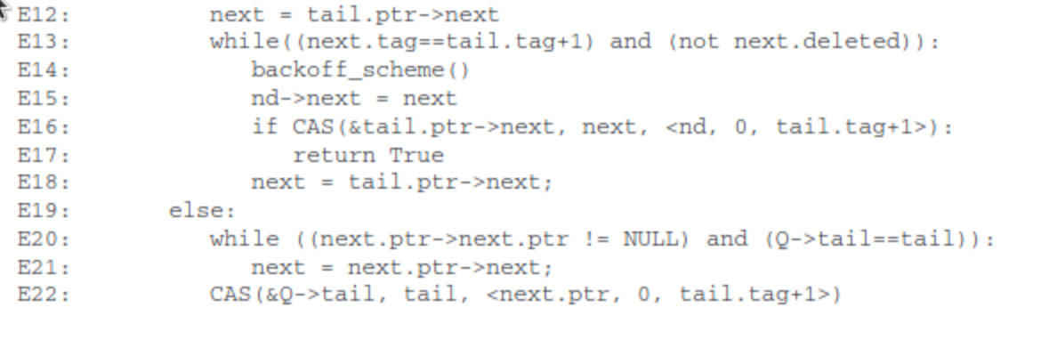
BQ Enqueue Algorithm

Slide 20
A Wait-free Queue as Fast as Fetch-and-Add
This is a wait free queue based on FAA which is also linearizable.
Usually CAS performs poorly, due to work wasted by CAS failure.This method also addresses this problem.
Here we use “fast-path-slow-path” methodology proposed by Kagon and Petrank.

Slide 21
Fast-path-slow-path methodology
We make use of this methodology to construct our wait free queue.
For a single operation 2 paths are designed, fast and slow.
Fast is designed to handle simple scenarios with little or no contention. Similarly Slow path is designed to handle complex scenarios and is sure to complete. This increases performance.

Slide 22
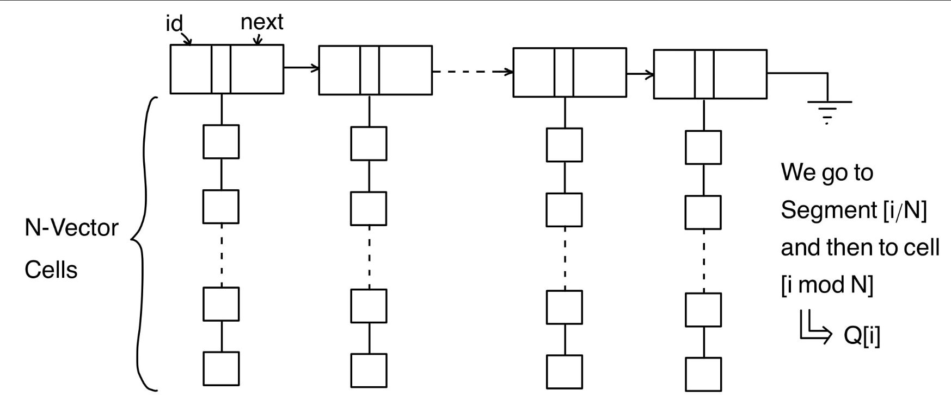
Data Structure details

Slide 23
Function calls
enqueue() enq_fast() enq_slow()
dequeue() deq_fast() deq_slow()
3. enq_fast()
4. enq_slow()
5. deq_fast() help_enq()
6. deq_slow() help_deq()
7. help_deq()
help_enq()
8. help_enq()

Slide 24
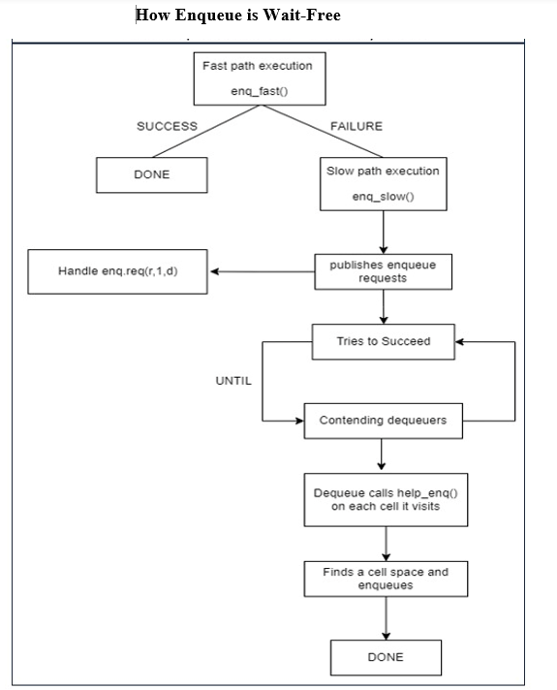

Slide 25
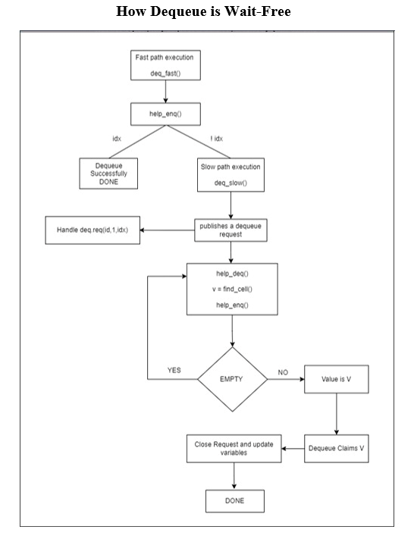

Slide 26
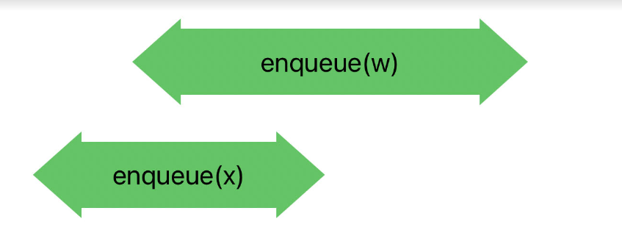
Linearizable points
Consider the case:-
Enq (e2) entered the timeline first but Enq (e1) got the location to enqueue its element
Now e2 is wants to get a location

Slide 27
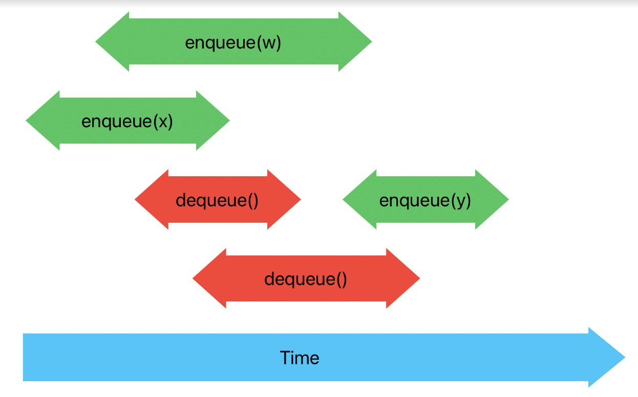
Linearizable points
Now , mean-while multiple dequeue s came in as shown
For, enq to have a point of linearization there, its contender, deq will help
Lp for e1 would be lp of enq_fast
Lp for e2 can be either * Lp of enq_slow * Lp of help_enq—-> (Called by contending Dequeue)

Slide 28
Linearizable points
Lp for deq (d1)
Lp of deq_fast
Lp of deq_slow
Both help_enq() and help_deq() support deq to achieve its operations and help pending enqueues.

Slide 29
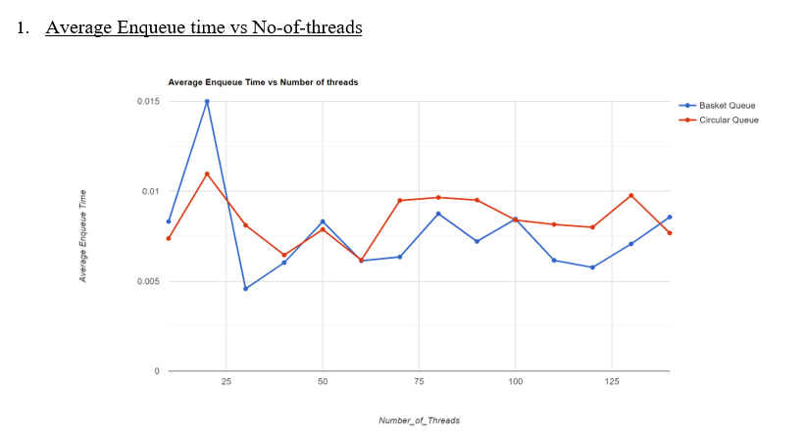
Graphs and Observations

Slide 30
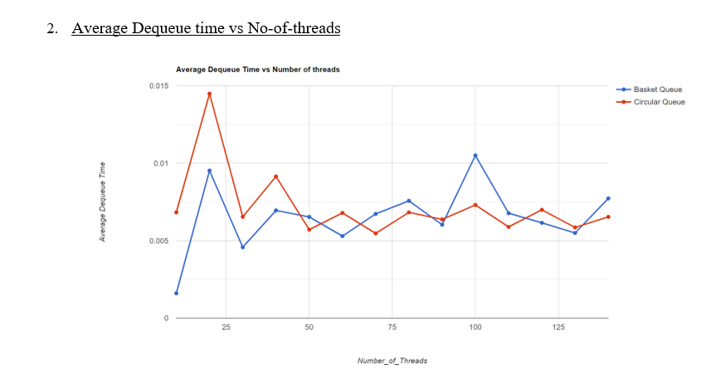
Graphs and Observations

Slide 31
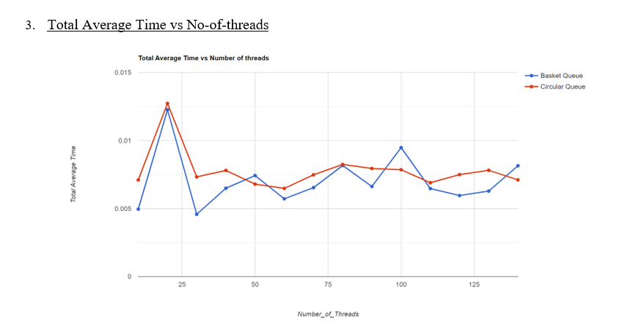
Graphs and Observations

Slide 32
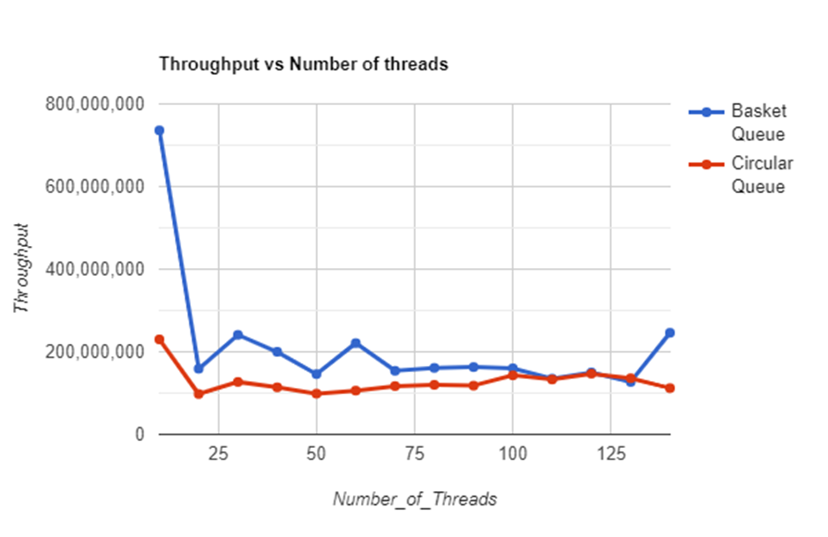
Graphs and Observations

Slide 33
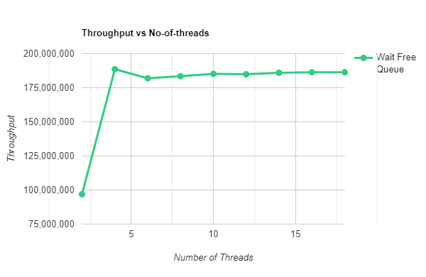
Graph for Throughput vs Number of Threads for Wait Free Queue
Wait-free queue

Slide 34
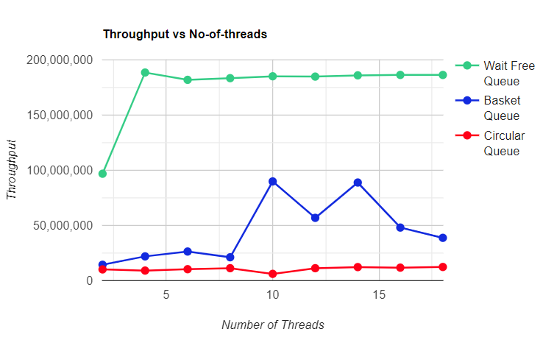
Graph for Throughput vs Number of Threads to compare
wait-free queue, circular queue and basket queue

Slide 35
Thank you!

